Slide 1

INTER IIT TECH MEET

Slide 2
BOSCH's Route Optimization Algorithm
IIT DHARWAD
Team members:
Janhavi
Harsh
Rupesh
Abhishek
Ashish

Slide 3
Visualisation of Problem Statement
Develop an algorithm to find optimal routes for buses to pick and drop people. Aim of the algorithm is to design route/routes for given pickup points and one common drop point minimizing total cost and considering other constraints which are capacity of bus, maximum distance per trip and time window. Boarding points of all passengers are pickup points. Final routes of buses will start from one of the pickup points and will finally end at BOSCH bidadi covering all the pickup points.
Routing with Time Window : In case every person has specific time window in which she/he will board the bus routing should strictly adhere to it. For example if person B1 boarding from location 1 has time window A to B then bus should not reach point 1 after B. Bus can reach point 1 before A but it should wait till time A for person B1.

Slide 4
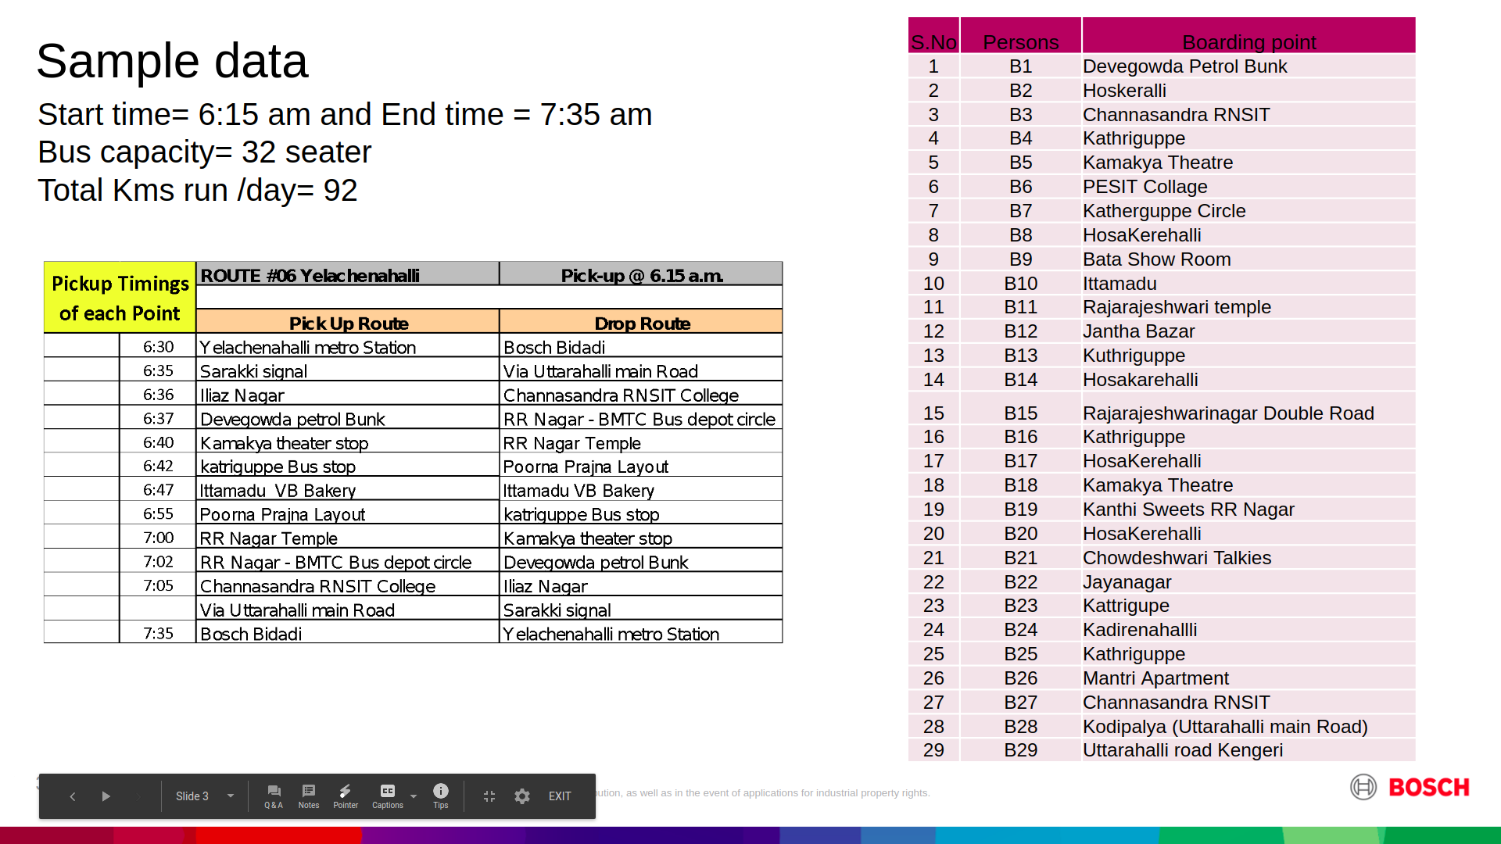
S.No | Persons | Boarding point
1 | B1 | Devegowda Petrol Bunk
2 | B2 | Hoskeralli
3 | B3 | Channasandra RNSIT
4 | B4 | Kathriguppe
5 | B5 | Kamakya Theatre
6 | B6 | PESIT Collage
7 | B7 | Katherguppe Circle
8 | B8 | HosaKerehalli
9 | B9 | Bata Show Room
10 | B10 | Ittamadu
11 | B11 | Rajarajeshwari temple
12 | B12 | Jantha Bazar
13 | B13 | Kuthriguppe
14 | B14 | Hosakarehalli
15 | B15 | Rajarajeshwarinagar Double Road
16 | B16 | Kathriguppe
17 | B17 | HosaKerehalli
18 | B18 | Kamakya Theatre
19 | B19 | Kanthi Sweets RR Nagar
20 | B20 | HosaKerehalli
21 | B21 | Chowdeshwari Talkies
22 | B22 | Jayanagar
23 | B23 | Kattrigupe
24 | B24 | Kadirenahallli
25 | B25 | Kathriguppe
26 | B26 | Mantri Apartment
27 | B27 | Channasandra RNSIT
28 | B28 | Kodipalya (Uttarahalli main Road)
29 | B29 | Uttarahalli road Kengeri

Slide 5
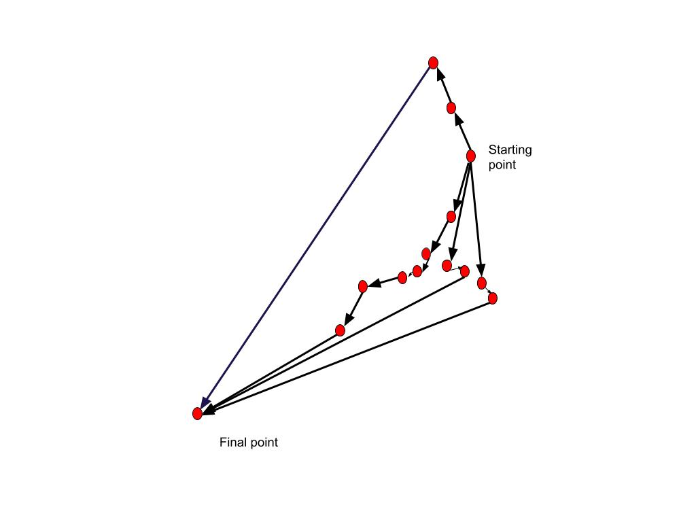

Slide 6
Route optimization algorithms help us to get the optimal path which reduces overall operational cost, and time. The naivest approach to this is to check all possible permutations of given routes which leads to non-deterministic polynomial-time complexity, taking considerably more time and computing power for real world application. So shortening the complexity of algorithm along with getting a reasonable optimal solution is a great challenge to overcome.

Slide 7
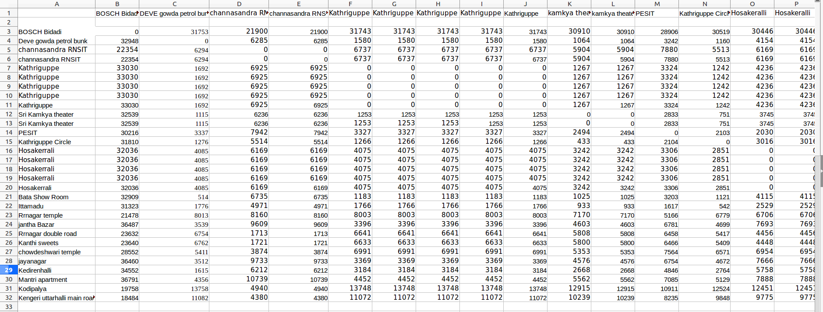
Distance matrix

Slide 8
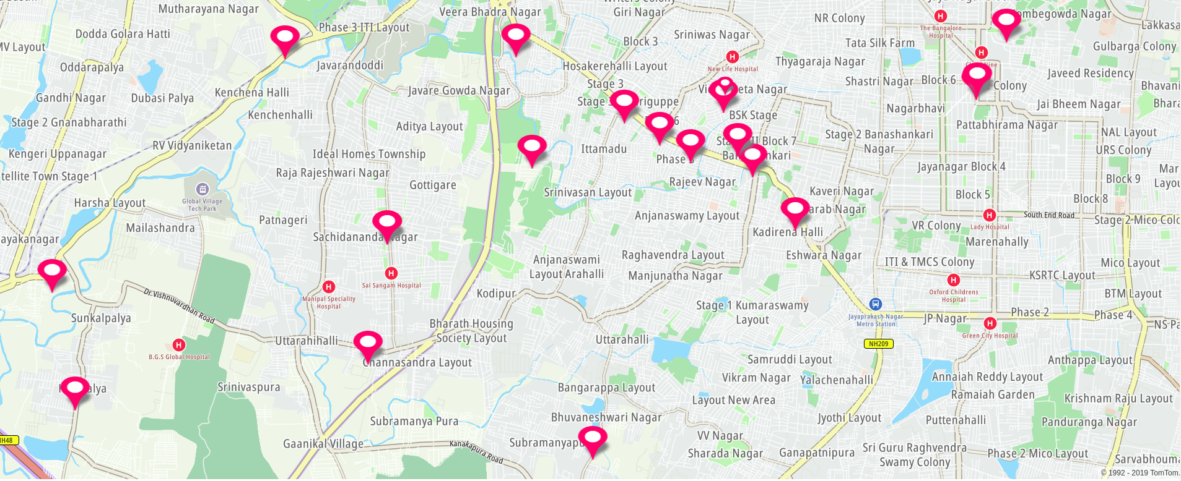
Location of all pickup points in Real Map

Slide 9
Constraints
Minimize operational cost.
Number of buses
Vehicle occupancy should be at least 85%.
Time window for pick up and drop off.

Slide 10
Assumptions
Algorithm gives route or set of routes for buses based at one drop point and one source (here according to sample data drop point is BOSCH bidadi and bus starts from point which gives most optimal solution from the set of input points) for number of geographically dispersed boarding points.
Each person has same time window i.e. 6:15 - 7:35.
Speed of bus is assumed to be 40km/hr.
Max distance a bus can travel in one day is 92 km.
Bus capacity is 32.

Slide 11
Algorithm
Overview :
The algorithm tries to group passengers in clusters. Each cluster is carried by a single bus.
The cluster is formed in such a way that it minimises both number of buses used and total distance covered by each bus keeping the max distance covered by any bus less than provided upper bound.
Minimal changes are made in algorithm to find optimal solution, depending on other constraints provided.

Slide 12
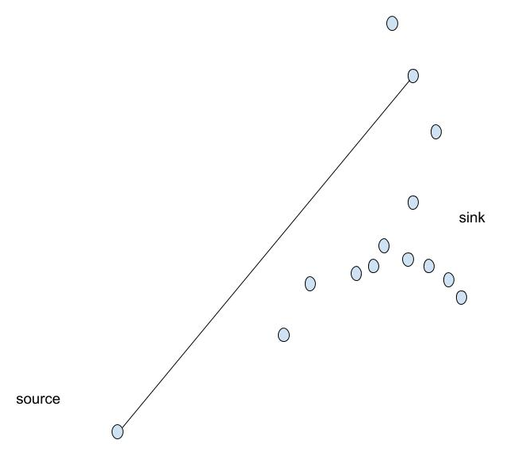
Algorithm
We fix the starting (the source) and ending (the sink) nodes of the buses.

Slide 13
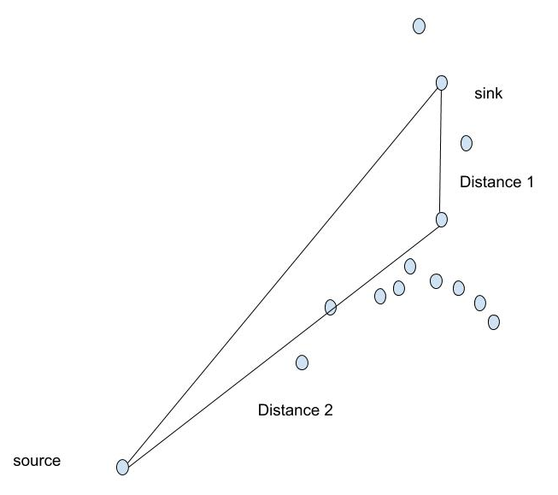
Algorithm
We sort the boarding points with key as average distance from the source and sink in decreasing order.

Slide 14
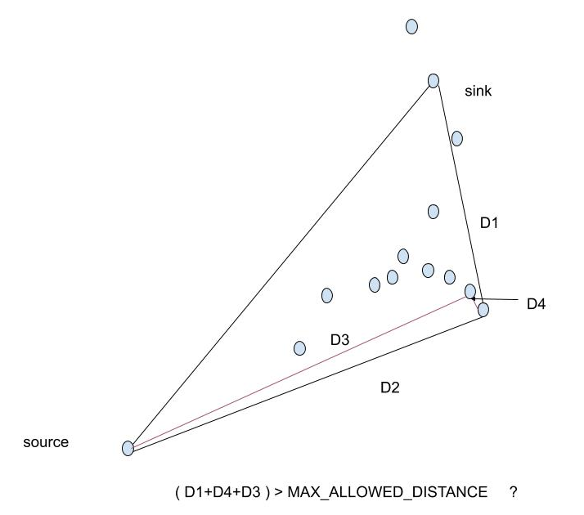
Algorithm
For the current cluster, we try to add the farthest node into this cluster. We check if after adding this node violates constraints like the total distance covered by the bus in the cluster exceeds the max allowed distance.

Slide 15
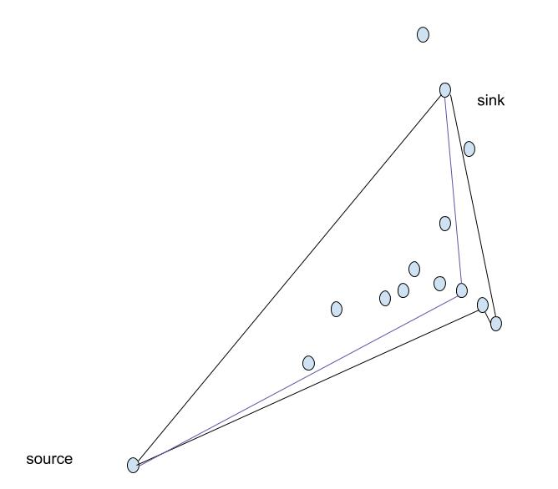
Algorithm
If the total calculated distance is more than max allowed distance, we create a new cluster and add the node to it. Else, add the node to current cluster and proceed further with other nodes.

Slide 16
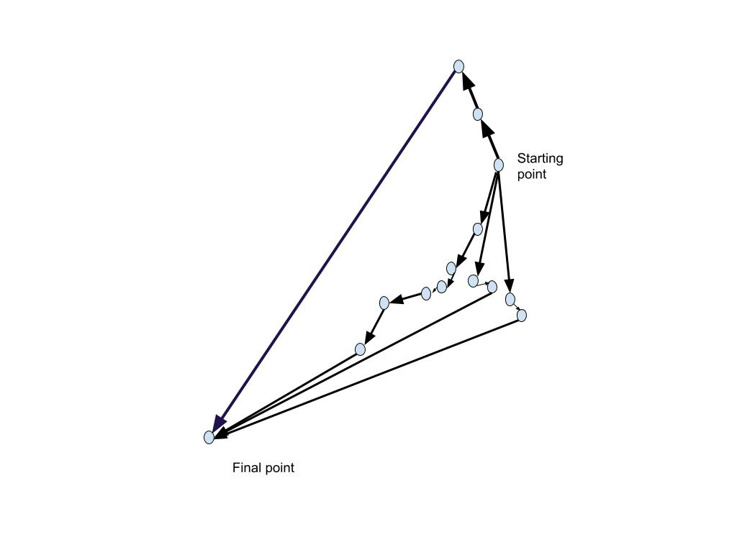
Algorithm
In case of time window constraint, the condition for forming new cluster is altered. While trying to add new point into the cluster, we check if the last point to be visited can be reached by the vehicle in its given time (also considering the time required, if any, by bus to wait if it reaches to pick any person before his/her time window). If not, we form new cluster even if it increases the number of buses.

Slide 17
Algorithm
To reach 85% occupancy with the given data points the maximum allowed distance constraint needs to be violated to obtain a feasible solution.

Slide 18
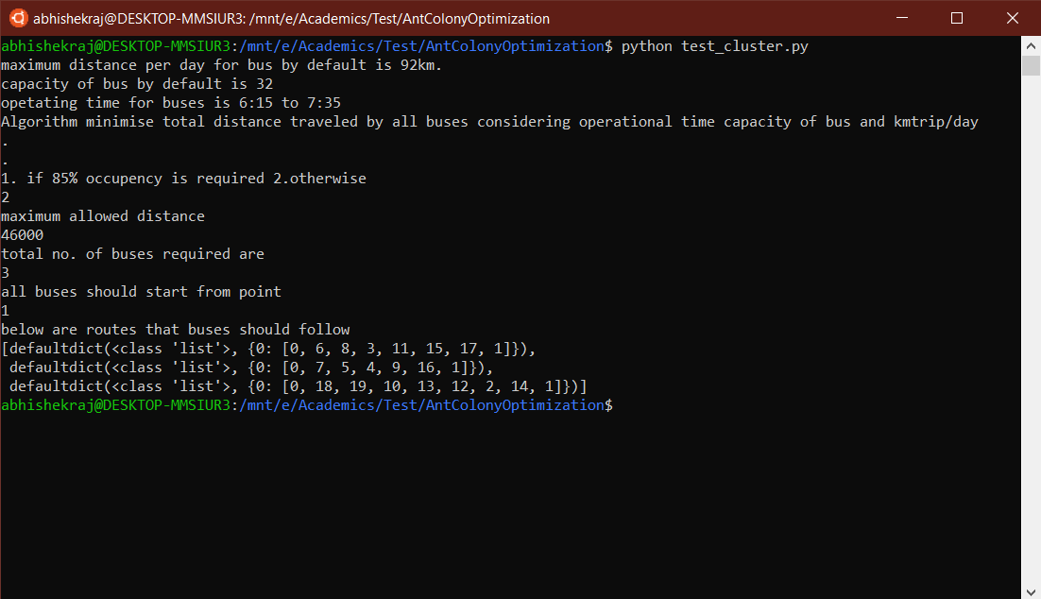

Slide 19
Comparison
We ran our algorithm on the input data provided with the assumptions stated earlier and compared with some other algorithms implementations available on internet :-
Ant Colony Optimization:
Shortest Path : 0 -> 19 ->18 -> 2 -> 12 -> 13 -> 10 -> 5 -> 7 -> 9 -> 6 -> 4 -> 1 -> 16 -> 11 -> 15 -> 17 -> 3 -> 8 -> 14
Distance: 58602 metres
Reference: Akavall’s Ant Colony Optimization[2]

Slide 20
Comparison
2. Tabu Search :
Shortest Path : 0 -> 19 ->18 -> 2 -> 12 -> 13 -> 10 -> 5 -> 7 -> 9 -> 6 -> 8 -> 1 -> 16 -> 15 -> 11 -> 17 -> 3 -> 4 -> 14
Distance : 58001 metres
Reference : Tabu search [3]

Slide 21
Comparison
3. Google’s OR tools:
Shortest Path: 0 -> 19 -> 18 -> 2 -> 12 -> 13 -> 14 -> 4 -> 3 -> 17 -> 11 -> 15 -> 16 -> 1 -> 8 -> 6 -> 9 -> 5 -> 7 -> 10
Distance : 59136 meters
Reference: Google OR tools VRP[4]

Slide 22
Comparison
4. Our Algorithm:
Shortest Path: 0 -> 18 -> 19 -> 10 -> 13 -> 12 -> 2 -> 14 -> 7 -> 5 -> 4 -> 9 -> 6 -> 1 -> 8 -> 3 -> 11 -> 15 -> 17 -> 16
Distance : 59315 meters
Reference: source code [5]

Slide 23
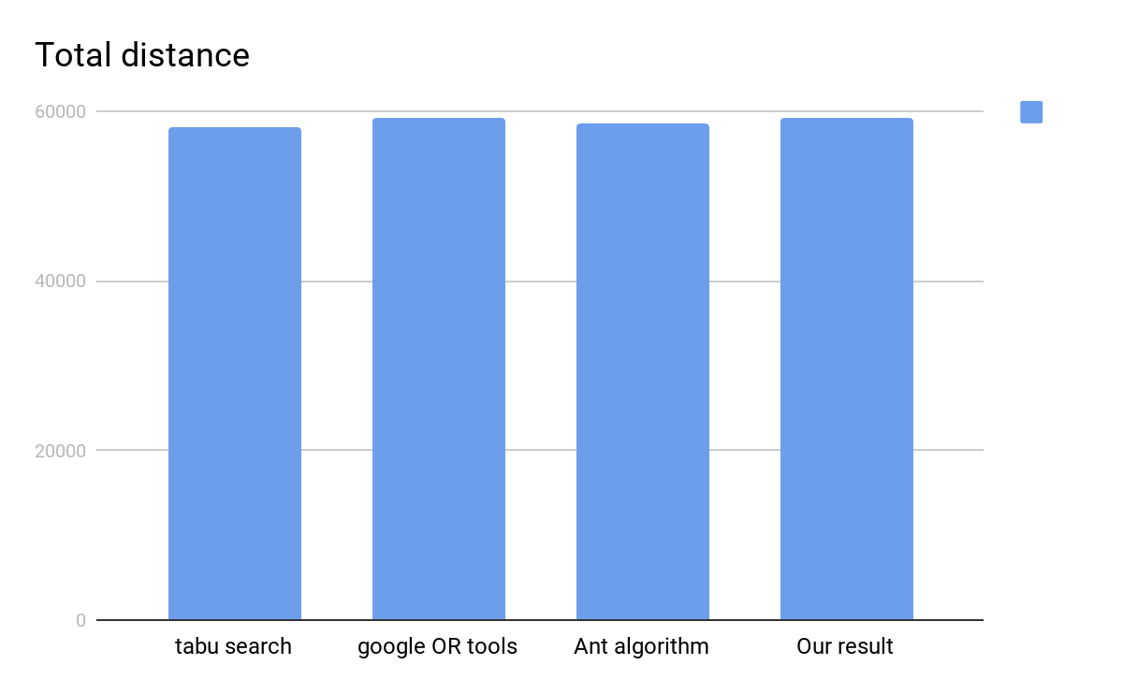

Slide 24
Conclusion
We ran our algorithm on the input data provided with the assumptions stated earlier and obtained the following path as result :-
Number of Buses: 3
Route for Bus 1: BOSCH bidadi(0) -> kathriguppe circle(6) -> Bata show room(8) -> kathriguppe(3)
-> jantha bazar(11) -> jayanagar(15) -> mantri apartment(17) -> deve gowda petrol bunk(1)
Distance travelled: 43258 meters
Route for Bus 2: BOSCH bidadi(0) -> Hosakerrali(7) -> PESIT college(5) -> sri kamkya theater(4)
-> ittamadu(9) -> kadirenahalli(16) -> deve gowda petrol bunk(1)
Distance travelled: 38194 meters
Route for Bus 3: BOSCH bidadi(0) -> kodipalya(18) -> kengeri uttarhalli main road(19) ->
Rajarajeshwari nagar temple(10) -> kanthi sweets(13) -> rajarajeshwari nagar double road(12) ->
channasandra RNSIT(2) -> chowdeshwari temple(14) -> devegowda petrol bunk(1)
Distance travelled: 37384 meters

Slide 25
BUS 1
First Cluster :

Slide 26
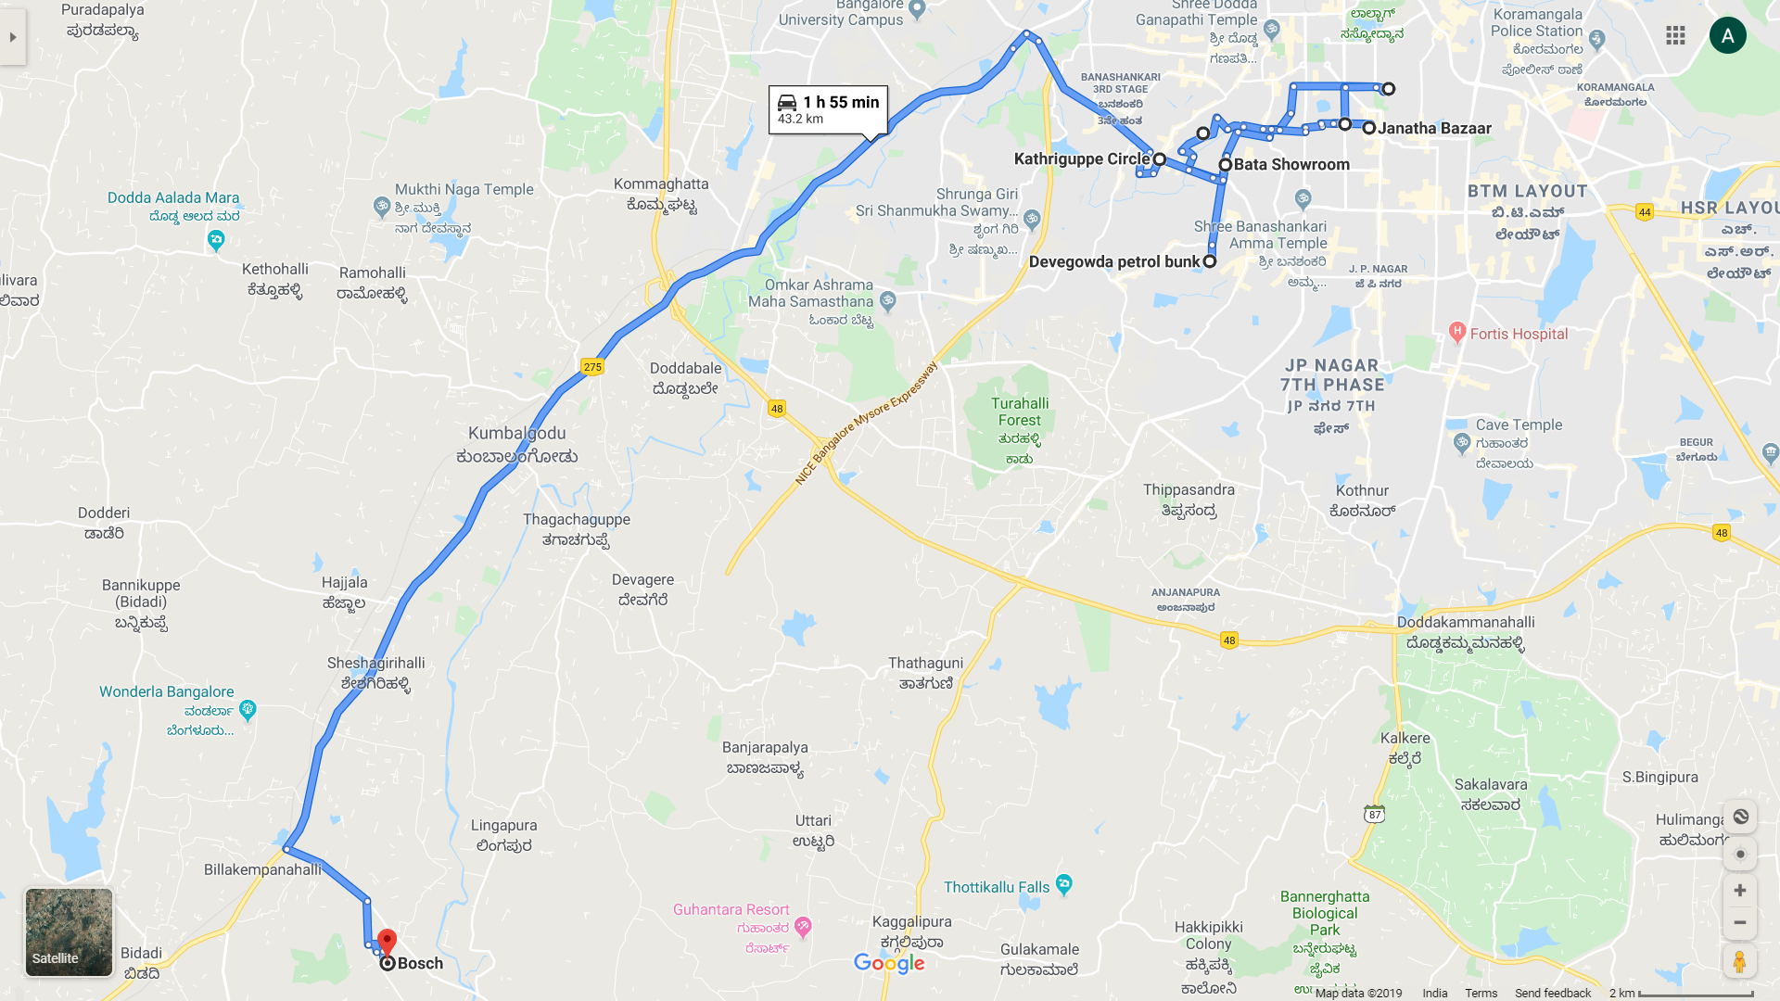

Slide 27
BUS 2
Second Cluster :

Slide 28
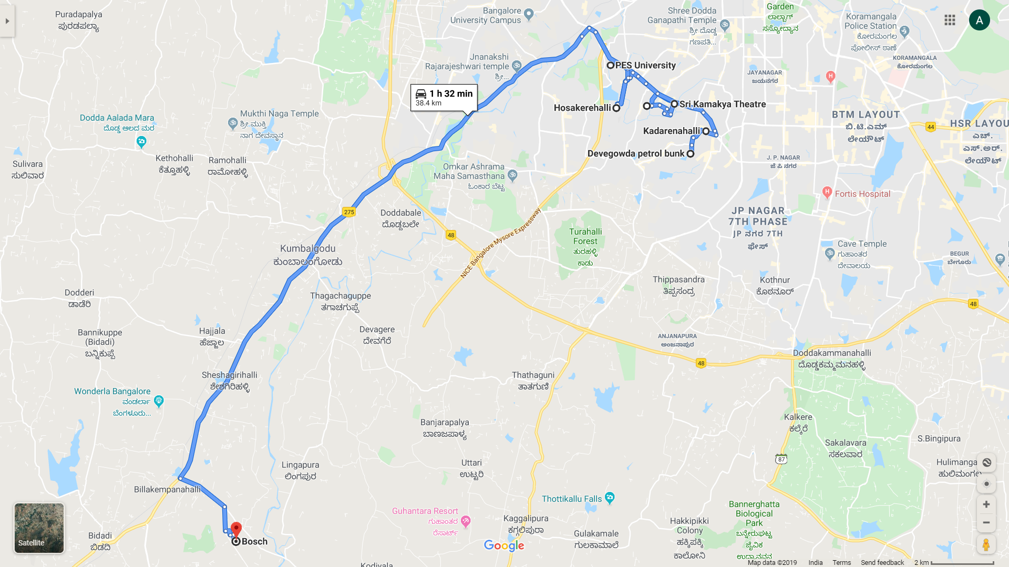

Slide 29
BUS 3
Third Cluster :

Slide 30
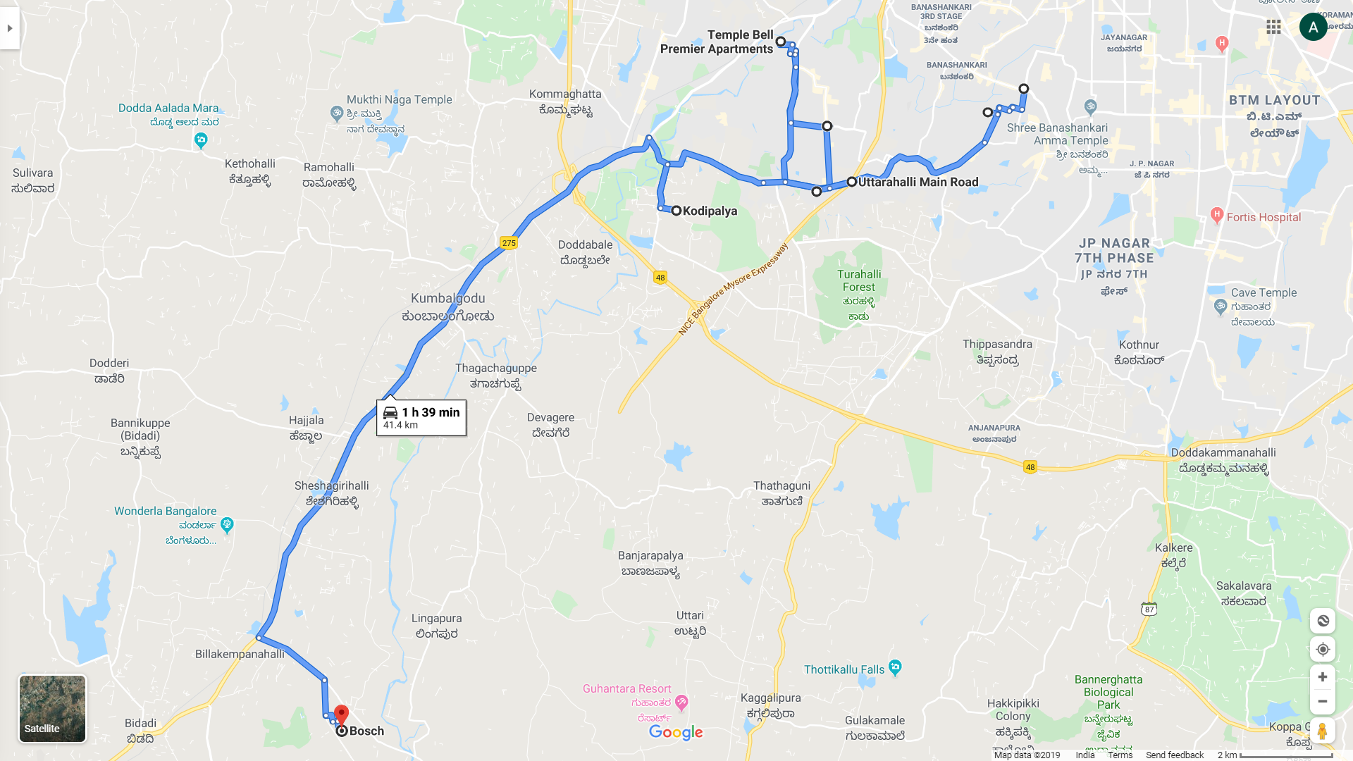

Slide 31
References
[1] Cordeau, J.-F., Desaulniers, G., Desrosiers, J., Solomon, M.M., Soumis, F. “VRP with Time
Windows”. In P. Toth and D. Vigo (eds.): The Vehicle Routing Problem, SIAM Monographs on
Discrete Mathematics and Applications, vol. 9, Philadelphia, PA, 157-193. 2002.
[2] https://github.com/Akavall/AntColonyOptimization
[3] https://www.techconductor.com/algorithms/python/Search/Tabu_Search.php
[4] https://developers.google.com/optimization/routing/vrp
[5] https://github.com/JanhaviDadhania/Solution-for-Vehicle-Routing-Problem-for-Employee-Transportation-Management

Slide 32
Thank You

